Slide 1
CS 4974 Independent Study
9/1/22 meeting
Student: Bug Lee

Slide 2
Last time, we discussed…
Writing down Assembly grammar for already available tools like Bison
Writing assembler as a first practice for writing Lexer/tokenizer and parser
Multi-pass design idea for Assembler
First pass: Construct tables that would be use for resolving symbols, label, etc in the second pass.
Second pass: assemble instructions into byte code.

Slide 3
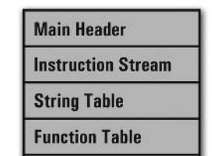
compiler
assembler
script.source
script.assembly
script.executable
Virtual Machine
CPU

Slide 4
Assembly Grammar

Slide 5
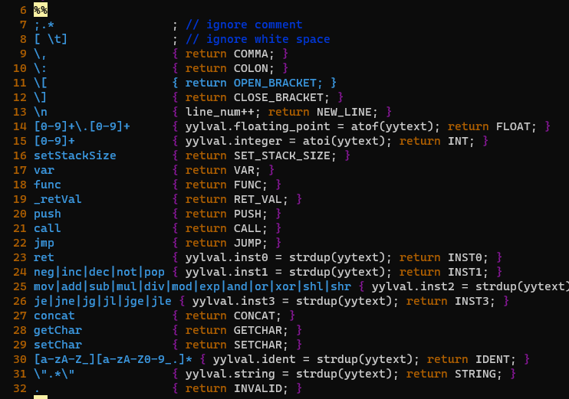
asm_lexer.l

Slide 6
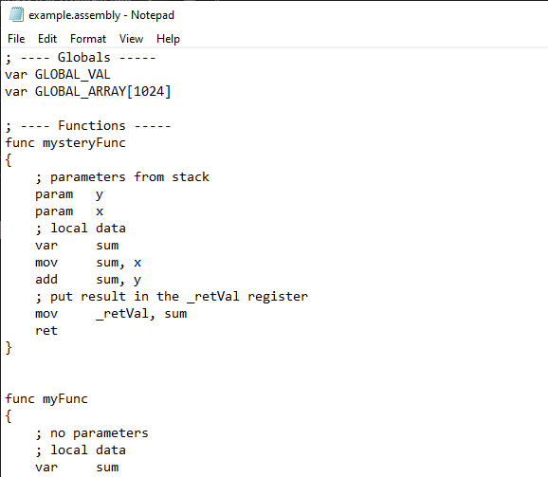

Slide 7
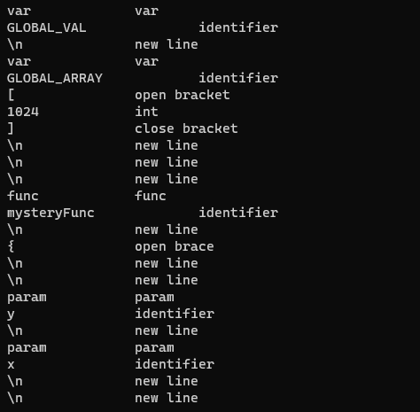

Slide 8
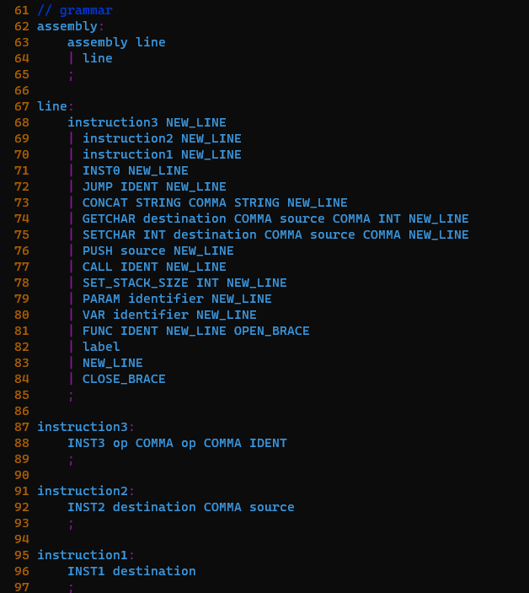
asm_parser.y

Slide 9
Assembler
week 1

Slide 10
Some changes
Programming in C++ instead of C
Focusing on implementing assembler itself rather than supporting data structure and string processing libraries.
Using C++ Catch2 for Testing Framework

Slide 11
Goal for current Assembler
In addition to the basic assembler functionality, goal is to add additional features like the directives for declaring variables, arrays, functions (scope) and so on.
Take advantage of flexibility that come with designing Virtual machine compare to running directly on physical hardware.
Put less burden on compiler.

Slide 12
Lexing State machine
0-9
White space
done
Int
‘.’
0-9
0-9
Float
White space
done
‘.’
*
Start
: , [ ] \n …
Delim
*
“
a-zA-Z0-9_
String
Ident
”
a-zA-Z0-9_
done
White space

Slide 13
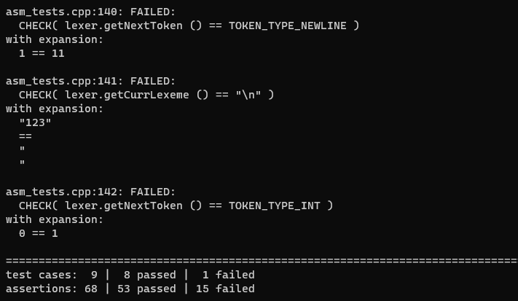

Slide 14
Plan for week 2
Finish Assembly lexer implementation and adding more test cases
Implement assembly parser
Top down, recursive descent approach
If there is time, start working on:
Integrate lexer and parser to assembly process for building executable.

